Slide 1
Purchase Pattern Analysis
Client Project Report
Project ID: CDACL005
Team Code: PTID – CDA – SEP - 25 -741
Batch: 12 – MAY – CDA – BUN – 040 – WDM1130 – BAN
Prepared By: Pruthiraj Samal (pruthirajsamal8802@gmail.com)

Slide 2
Objectives
Week - 3
Visualize product occurrences and trends
Implement Apriori algorithm for market basket analysis
Identify frequent itemsets and association rules
Visualize the results

Slide 3
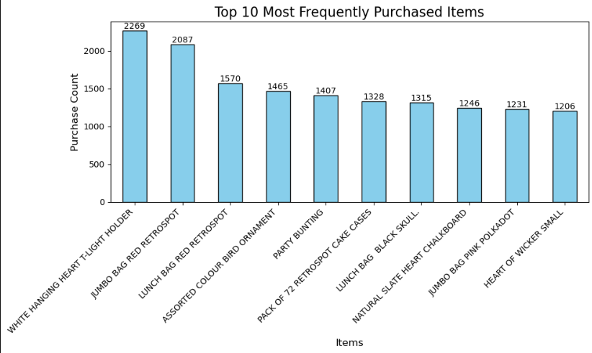
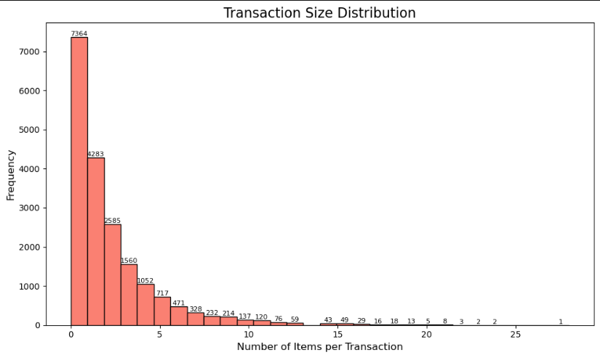
Data Visualization
Explore product frequency and trends
Understand popular products

Slide 4
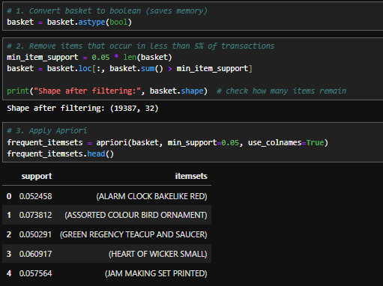
Apriori Algorithm
Find products often bought together
Steps:
  Identify frequent itemsets (support)
  Generate association rules (confidence & lift)

Slide 5
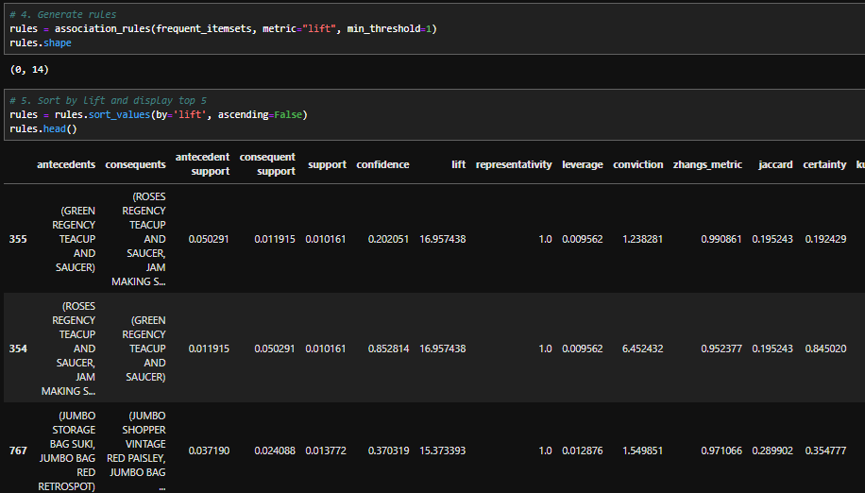
Top Association Rules
Focus on top 10 rules (by lift)
Insight: Products often bought together → cross-selling opportunity

Slide 6
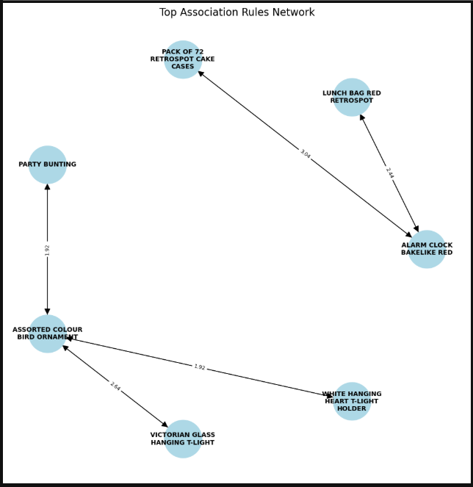
Network Visualization

Slide 7
Key Insights
Frequent product combinations identified
High lift → strong association
Helps in marketing strategies and recommendations

Slide 8
THANK YOU

